Slide 1

ADVENTURE WORKS DATA ANALYSIS

Slide 2
Today’s Agenda
Group Members
Summary of the Project
KPI List
Excel Dashboard
Tableau Dashboard
Power BI Dashboard
SQL Analysis
Suggestions
Key Takeaways

Slide 3
Group Members
Manali Sachin Gaikwad
Gurrala Charan
Mohammadjuned Allauddin Halakarni
Shivendra Bhushan Godiyal
Abhisha Velsamy

Slide 4
Summary of the Project
This project focuses on analyzing Adventure Works sales data across multiple years to evaluate overall business performance.
The primary objective is to understand sales trends, profit behavior, and order quantity patterns over time.
The analysis highlights top-performing products, identifies peak sales months and quarters, and compares year-wise revenue growth.
Region-wise and time-based insights help uncover seasonality and performance variations.
Interactive dashboards were created using Excel, Tableau, and Power BI to visualize KPIs and trends effectively.
SQL was used to extract data, perform joins, clean records, and compute key metrics for accurate reporting and analysis.

Slide 5

KPI List
Total Sales
Total Profit
Total Quantity Sold
Top 5 Products
Region Wise Sales
Top Products
Quarter-wise Profit
Year-wise Sales Comparison
Month-wise Sales Trend

Slide 6
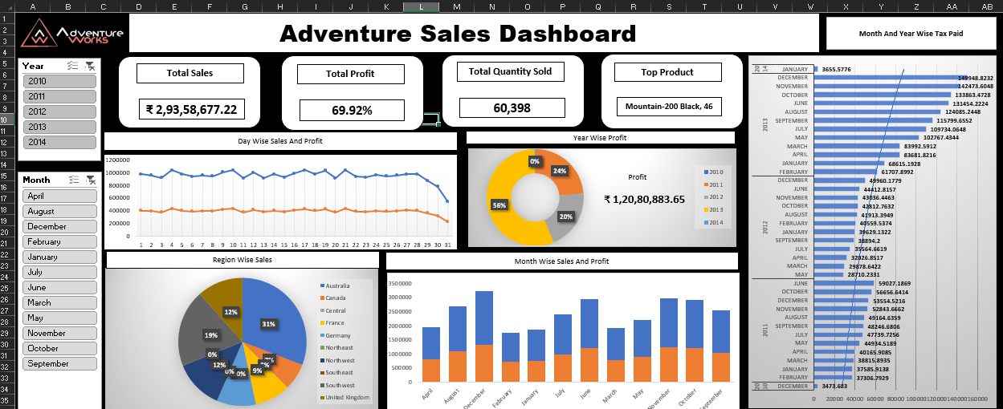
EXCEL DASHBOARD

Slide 7
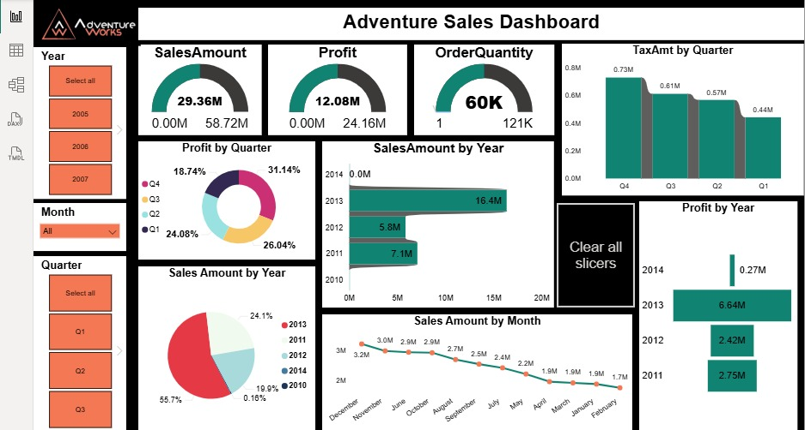
POWER BI DASHBOARD

Slide 8
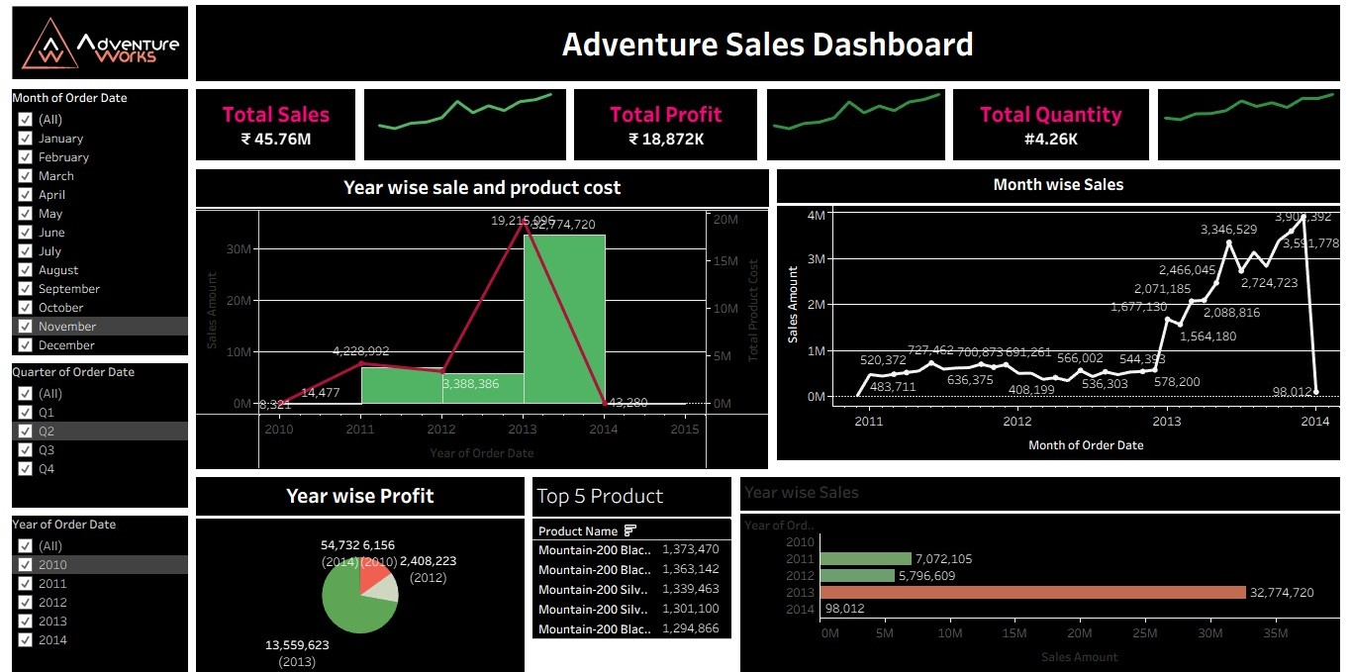
TABLEAU DASHBOARD

Slide 9
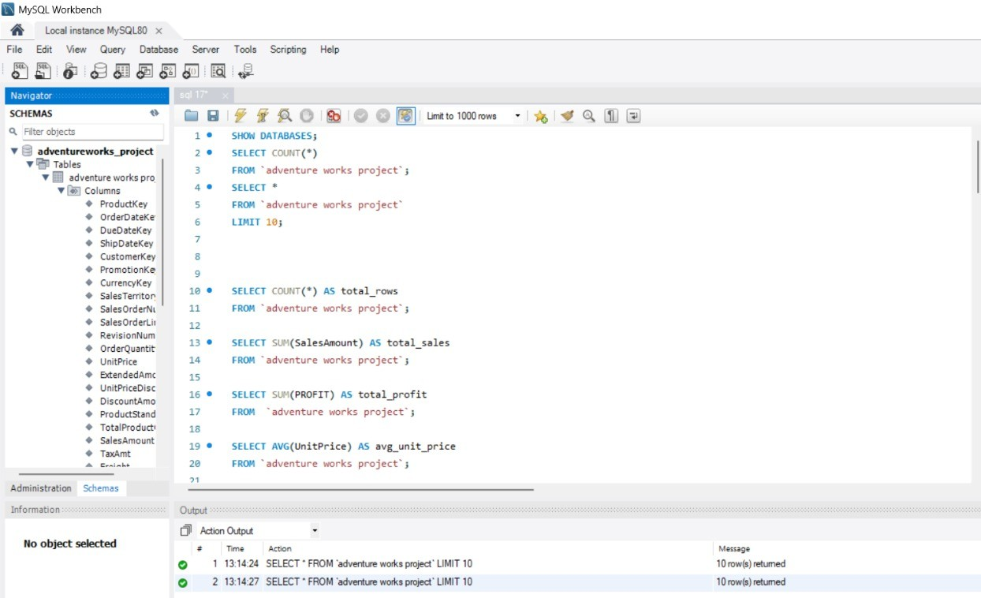
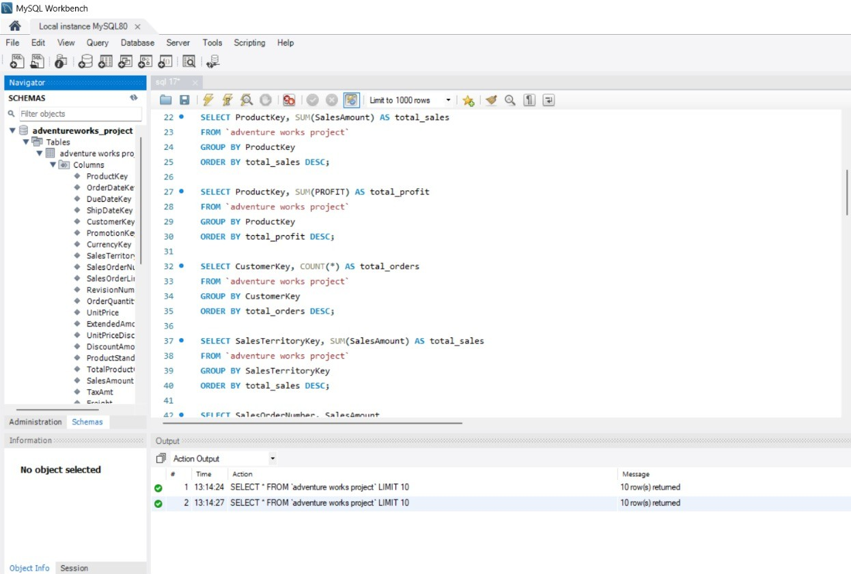
SQL SCRIPT

Slide 10
Suggestions
Focus marketing and sales efforts on top-performing products such as the Mountain-200 series to maximize revenue.
Increase promotional campaigns during high-sales months to further boost peak-season performance.
Introduce targeted offers and discounts in low-performing months to reduce sales fluctuations.
Monitor quarter-wise profit trends, especially in early quarters, to address potential revenue drops.
Strengthen sales strategies in underperforming regions using region-specific promotions.
Analyze tax and cost patterns to improve overall profit margins.
Regularly track KPIs through dashboards to support real-time decision-making.

Slide 11

Key Takeaways
Sales analysis clearly highlights growth trends and seasonal patterns.
Year-wise and month-wise comparisons help identify peak and low business periods.
Dashboards convert complex datasets into easy-to-understand visuals.
Using multiple BI tools provides better validation and deeper insights.
Product-level analysis supports focused and efficient business strategies.
Data-driven insights enable more accurate planning and forecasting.

Slide 12

Conclusion
Successfully analyzed Adventure Works sales data across multiple years.
Built interactive and insightful dashboards using Excel, Tableau, and Power BI.
Used SQL for data extraction, cleaning, and aggregation.
Identified key sales, profit, and performance trends.
Demonstrated strong skills in data analysis, visualization, and business insight generation.

Slide 13
THANK YOU

